Slide 1
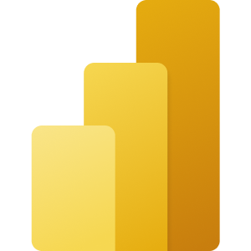
Alert Dashboard
Microsoft Power BI
This dashboard is showing all received alerts from market in a pharmaceutical company (alerts are products which were scanned and the system showed up the medicine is unknown), filters shows also alerts just received in Prague Site.
The dashboard might show number produced by the production machine, by the production date or by alert date and so on…

Slide 2


